Slide 1
Identifying Theme
LT: I can work with my peers to identify the theme and how the elements of plot contribute to the theme.

Slide 2
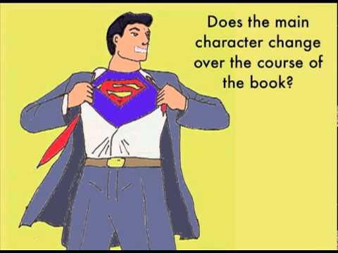
What is Theme?

Slide 3
Theme Defined:
“Theme is defined as a main idea or an underlying meaning of a literary work that may be stated directly or indirectly” (Literary Devices).
Major vs. Minor
Repeatedly addressed throughout the text
Appears briefly

Slide 4
Characteristics of Theme:
It is a moral message
Universal, applies to world beyond the story and it’s characters
It is NOT simply a TOPIC
Can have several themes

Slide 5
How do I find the theme?
Look at how character(s) develop
Look for clear statements of the theme
Examine the Title
(and anywhere it is mentioned in the text)
Examine the conflict

Slide 6
Group Activity:
LT: I can work with my peers to identify the theme and how the elements of plot contribute to the theme.
TASK: As a group, you will be responsible for identifying the theme and analyzing how the different elements of plot contribute to the theme.

Slide 7
Group Member Roles:
Each group member will focus on a different element that contributes to the theme. You will choose your roles, then individually read the text to focus on analyzing your element in the story.
Role A: Characters
Role B: Conflict
Role C: Setting

Slide 8
Period 1 Groups:
1. Tariq, Jaimee, Cayla
2. Dustin, Marissa,Isaac
3.Haley, Genna, Hunter
4.Antonio, Kayla, NaNa
5.Ahmad, Alex P., Madie
6.Garrett, Alissa, Maddux
7.Kalissa, Kylie, Bailey
8.Jacob, Drew, Joshua
9.Luke, Bishop, Ana,
Mikey
10.Amanda, Ally, Alex Y.,
Sam
11.Raequan, Tandra,
Alex N.

Slide 9
Period 2 Groups:
1.Kyle, Maddi, Brandon
2.Luke, Spencer, Mo
3.Cameron, Abbey H.,Jon
4.Yuba, Abbey B., Dominic
5.Nick, Krista, Jacob
6.Jordan, Morgan, Logan
7.Dalton, Joshua,
Aleacia
8.Tyler, Huy, Casey
9.Charles, Christina,
Steven
10.Devin, Katherina, Eric

Slide 10
Period 3 Groups:
1.Quay, Anna, Ishan
2.Carl, Dylan, Jay
3. David, Cheyenne,
Brittany
4.Mitch, Eric, Shaam
5. Derek, Elijah, Alex
6.Cody, Justin, Darin
7. Bill, Ben, Dillan
Victor, Jacob, Matt
Emily, Erebi, Cole
10.Brooke, Sean, Orion
11.Diamah, Rasha Mae, Connor

